Slide 1
Detection of Anthropogenic Impacts on Snowpack Variability in Western US.
2024 IMSC presentation
Shiheng Duan, Céline Bonfils, Giuliana Pallotta
Lawrence Livermore National Laboratory
June 28, 2024

Slide 2
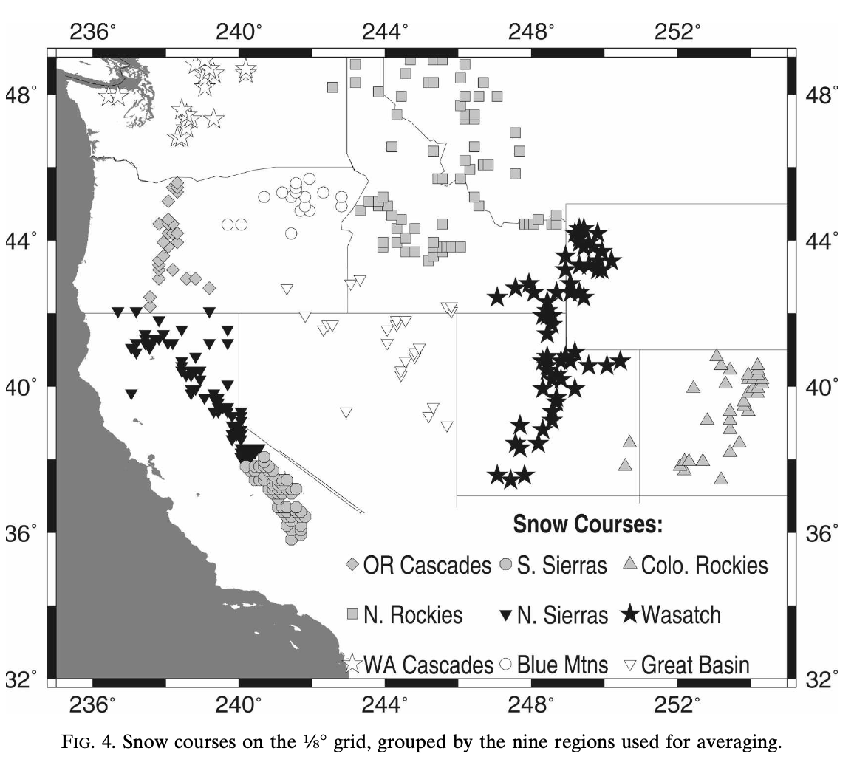
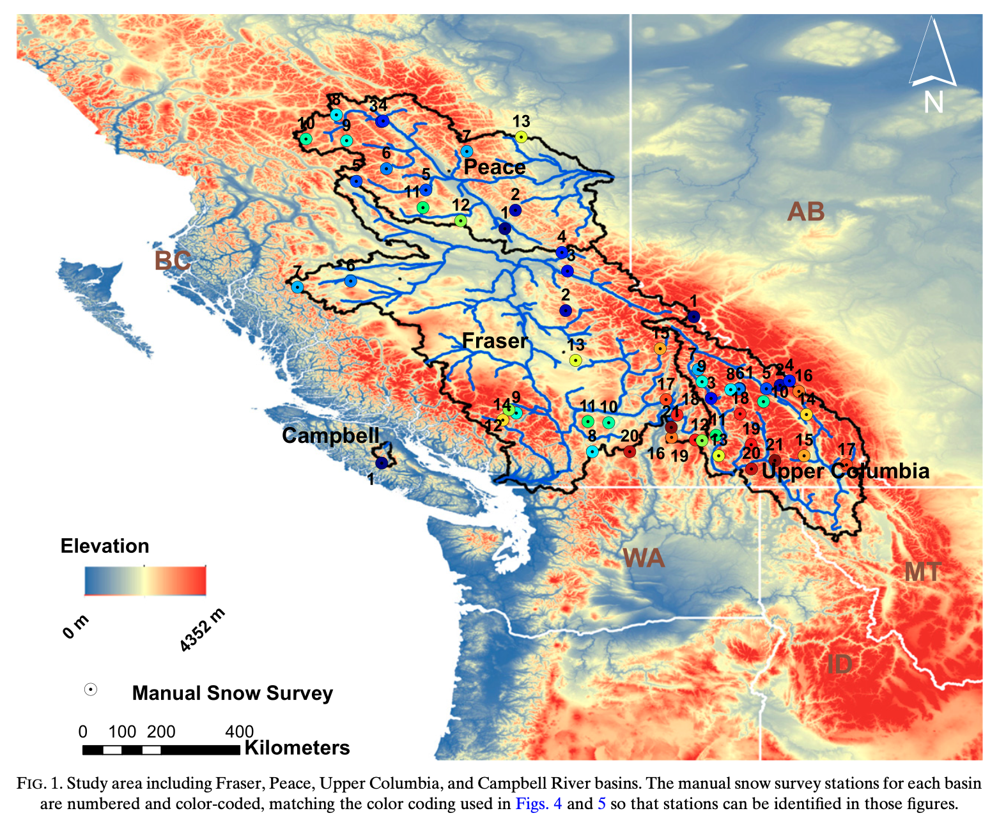
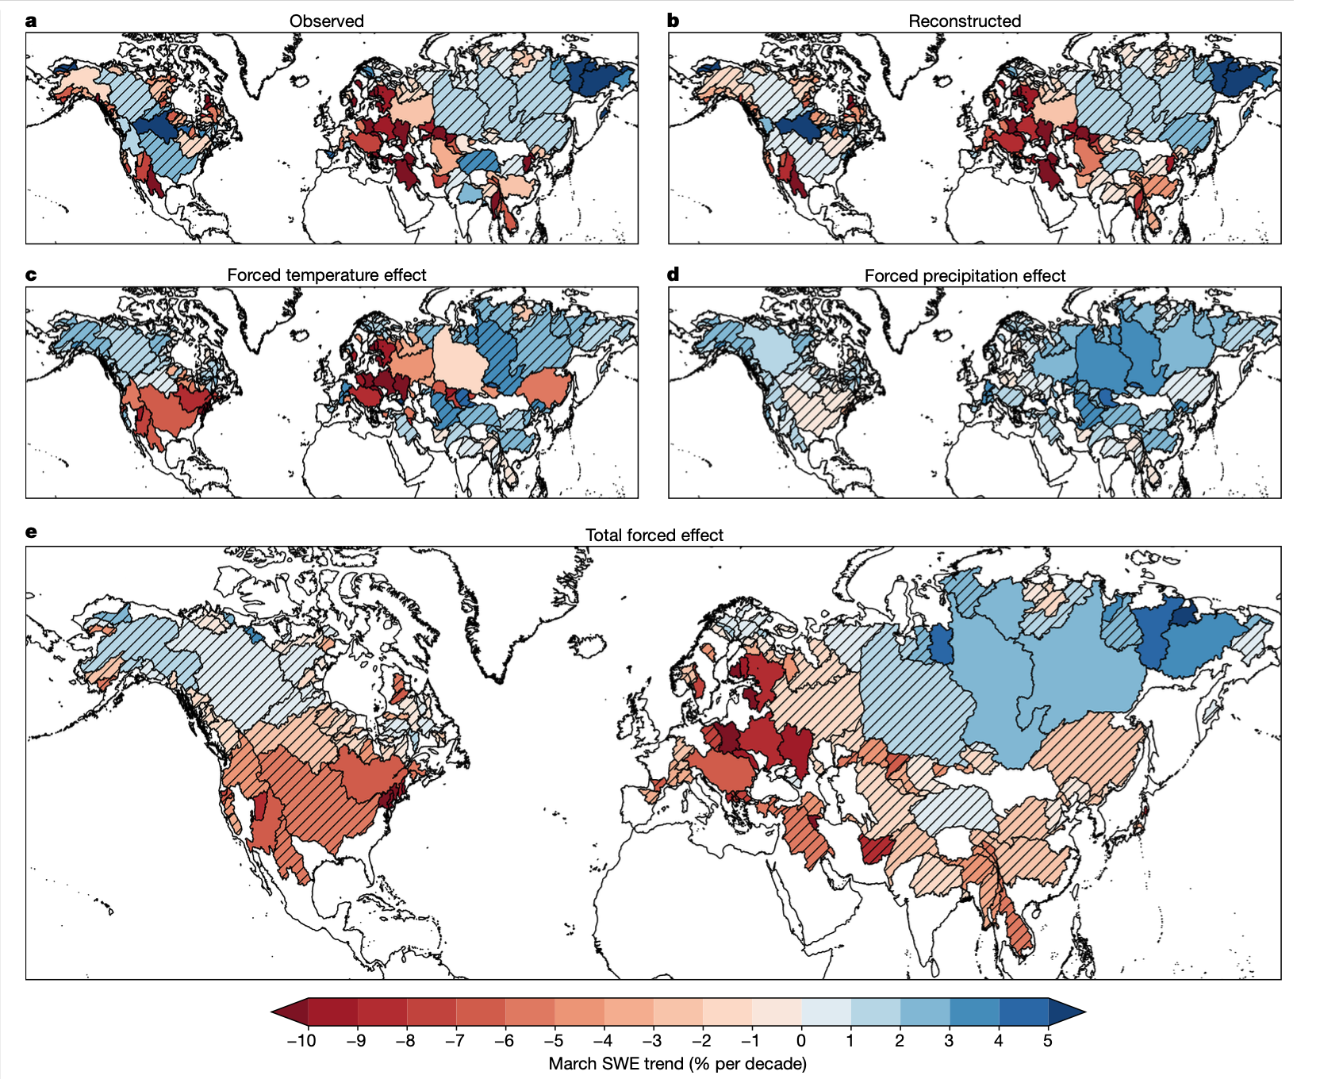
Previous Studies on Snowpack
Human fingerprints have been detected in various hydroclimate components
Snow water equivalent (SWE) is noisy:
Use normalized SWE (nSWE): SWE divided by accumulated precipitation
April 1st nSWE when peak SWE
Spatial aggregation:
Basin-mean or area-mean (Pierce et al., 2008, Najafi et al., 2017, Gottlieb et al., 2024)
Temporal aggregation:
5-yr running mean (e.g., Najafi et al., 2017)
A pattern-based fingerprint with high spatial resolution
CMIP6 simulations
High-resolution hydrological models
High-resolution observation/reanalysis
Figure. Study domains in Pierce et al., 2008, Najafi et al., 2017 and Gottlieb et al., 2024

Slide 3
Pattern-Based Fingerprint
Multi-model ensemble mean → forced component
Take the first empirical orthogonal function (EOF). Spatial pattern is referred to as “fingerprint”
Observations/reanalysis and piControl simulations are projected onto “fingerprint”. Pseudo-PC is used to evaluate signal and noise strength, and further signal-to-noise ratio (SNR)
Anthropogenic signal is detectable when SNR>2
Multi-model Ensemble Mean
Observations
piControl
Fingerprint
Obs pseudo-PC
piControl pseudo-PC
Signal trend strength
Noise trend strength
Signal-to-Noise Ratio

Slide 4
Workflow
CMIP6 Simulations
ACCESS-ESM1-5, EC-Earth3, IPSL-CM6A-LR, MIROC6, and MPI-ESM1-2-LR
20 ensemble members from historical simulations
300 yr piControl simulations.
BCSD
Bias Correction and Spatial Disaggregation
Livneh13 as reference dataset.
Daily data with 6km horizontal resolution (1/16 degree)
Variables: precipitation, tmax and tmin.
MetSim
Meteorology Simulator disaggregate daily timestep to 3-houly time step.
Input: BCSD daily precipitation, tmax and tmin; wind speed (daily climatology from CFS reanalysis)
Output: precipitation, temperature, pressure, radiation, vapor pressure and wind speed at 3-hourly interval.
VIC
Variable Infiltration Capacity model takes MetSim output as input forcings.
Parameters from Schaperow et al 2021.
Output: daily snow water equivalent → April 1st normalized SWE.
Notes:
Climate Forecast System (CFS) over the period of 1980 to 1984

Slide 5
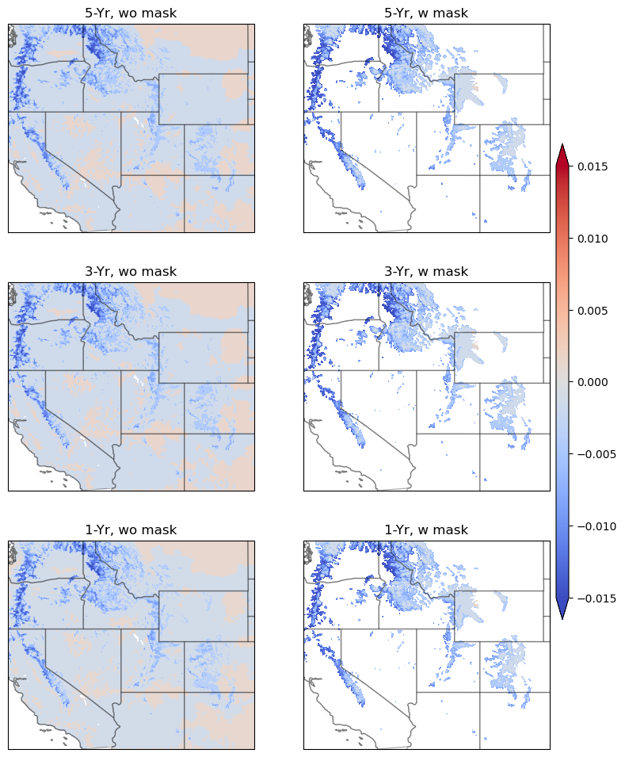
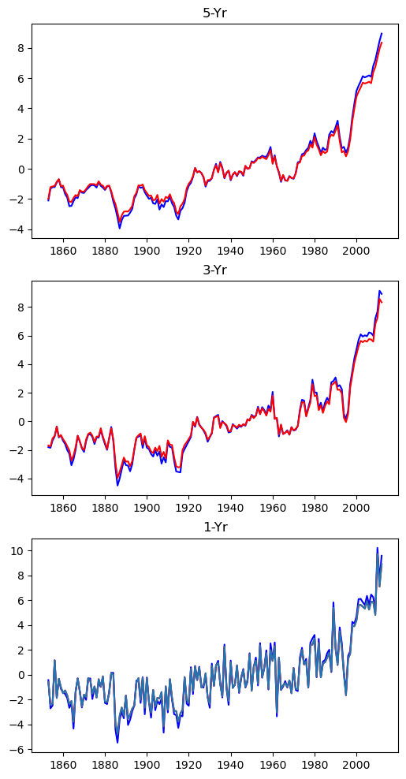
Fingerprint
High-res fingerprint
At 6-km resolution
With and w/o mask show similar results
Rolling average reveals clear PC time series
But
Noise is still here in the PC, primarily due to the fine resolution and small domain
Large uncertainty from the “observation” datasets

Slide 6
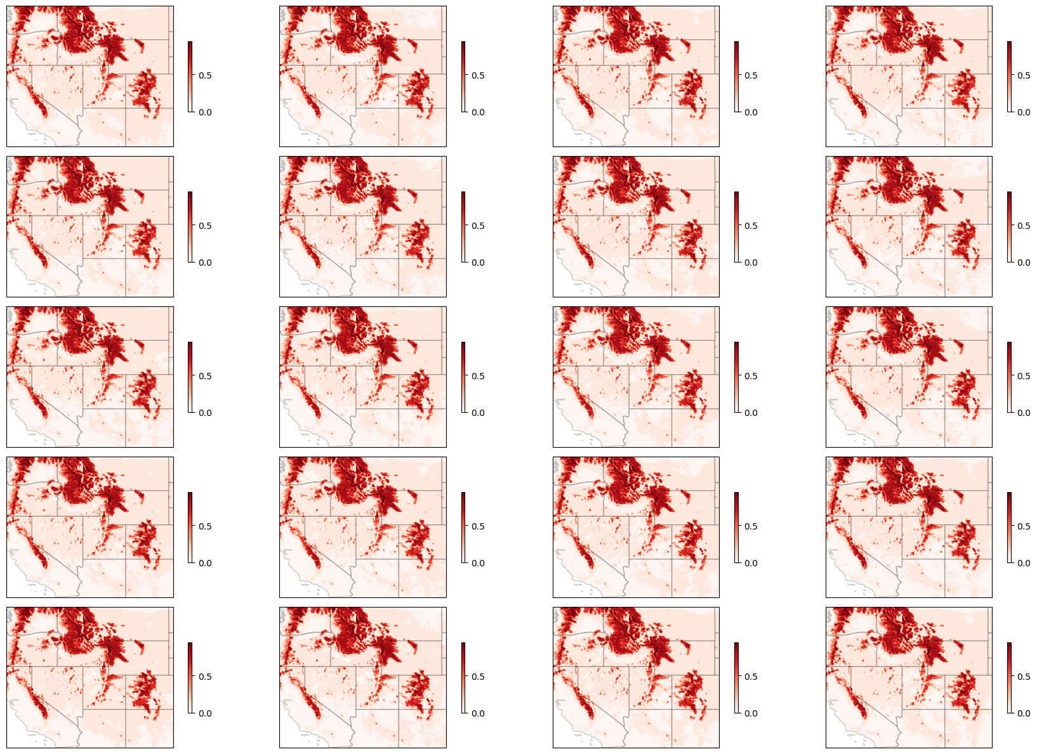
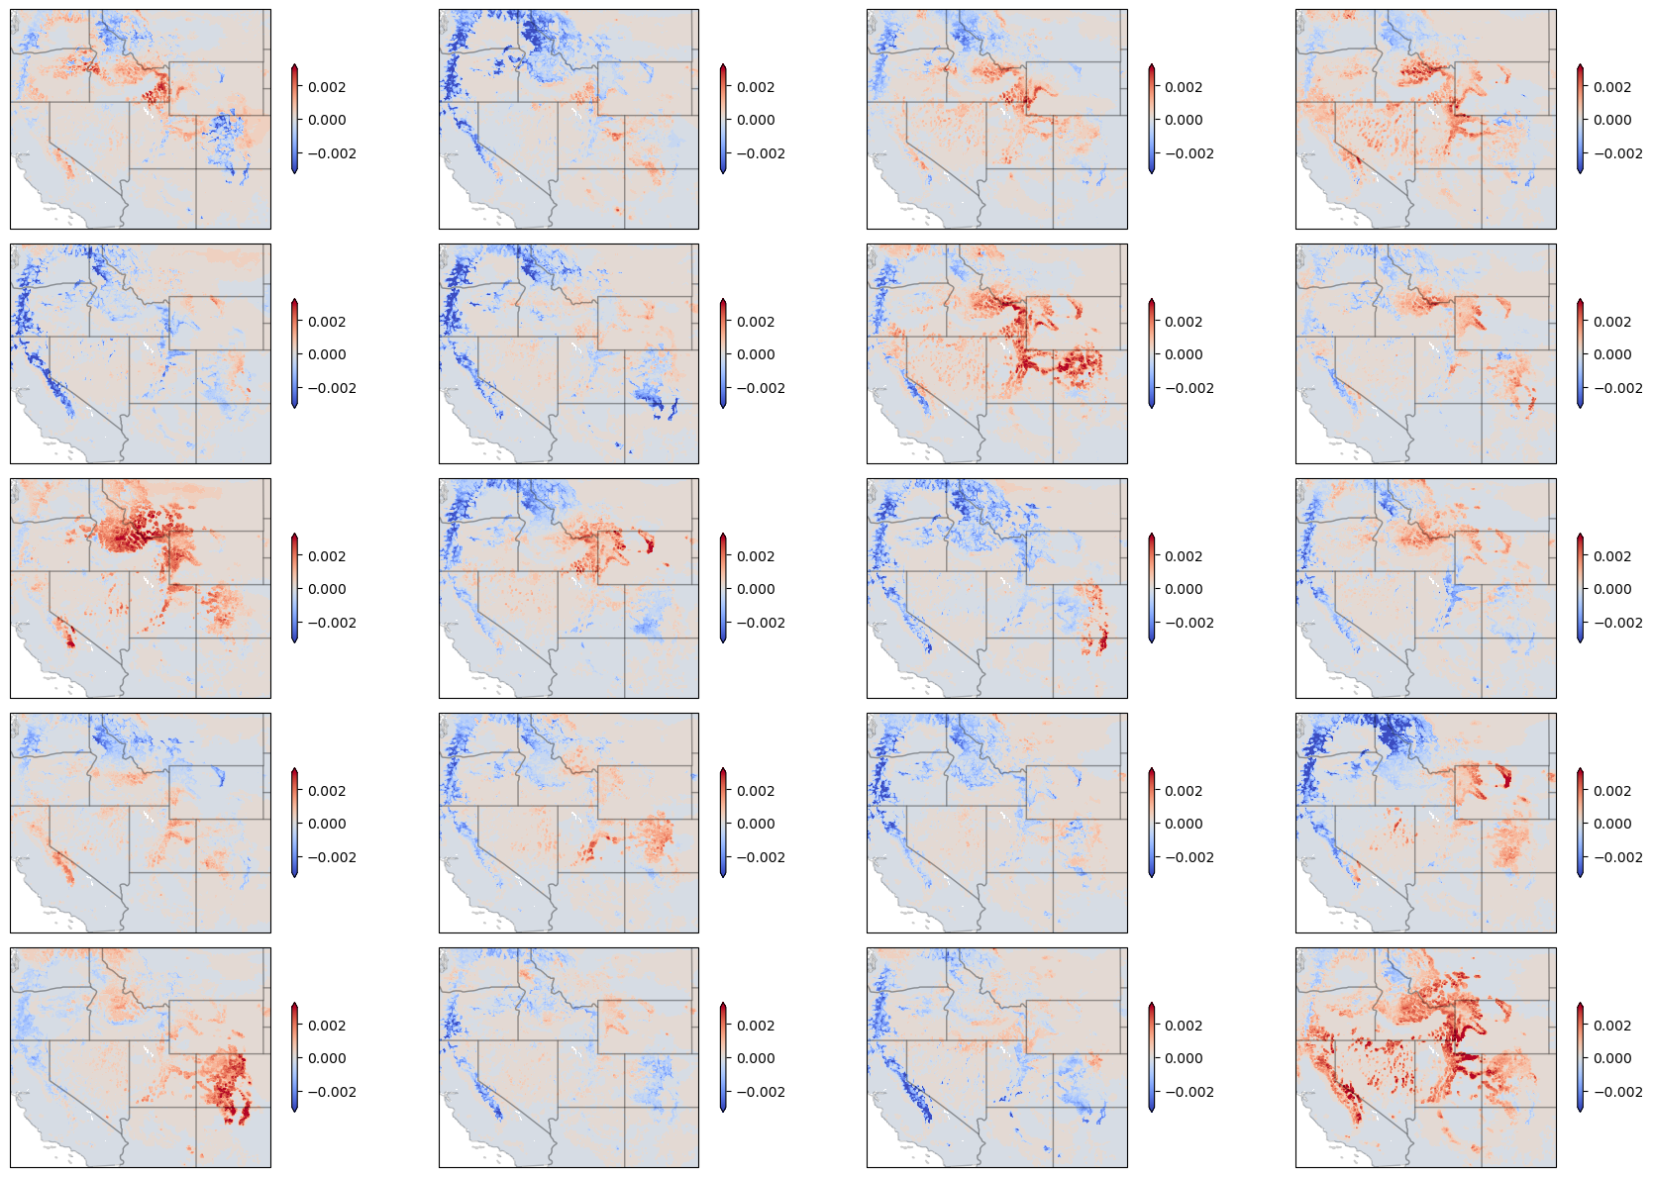
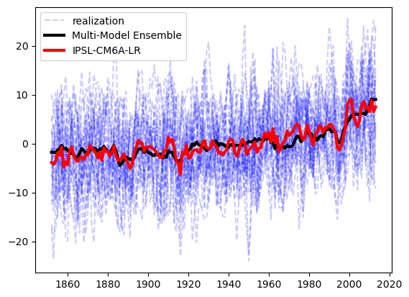
Noise in Climate Simulations
Figure. Climatology and trend maps of April 1st nSWE for 20 ensemble members from IPSL-CM6A-LR-VIC simulation from 1953 to 2009 with 3-yr rolling average.

Slide 7
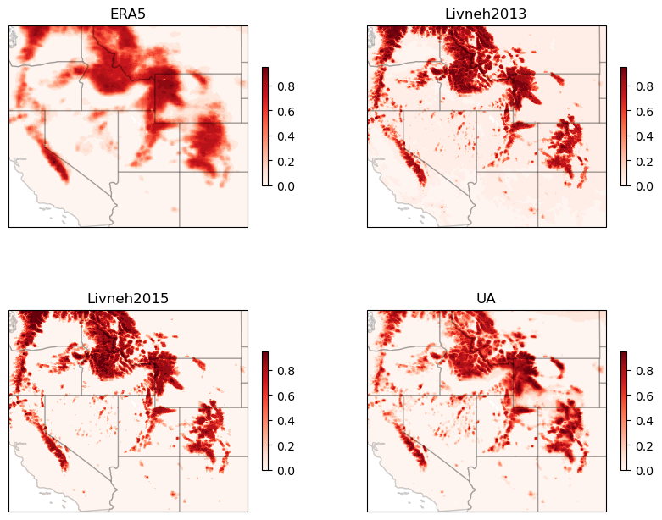
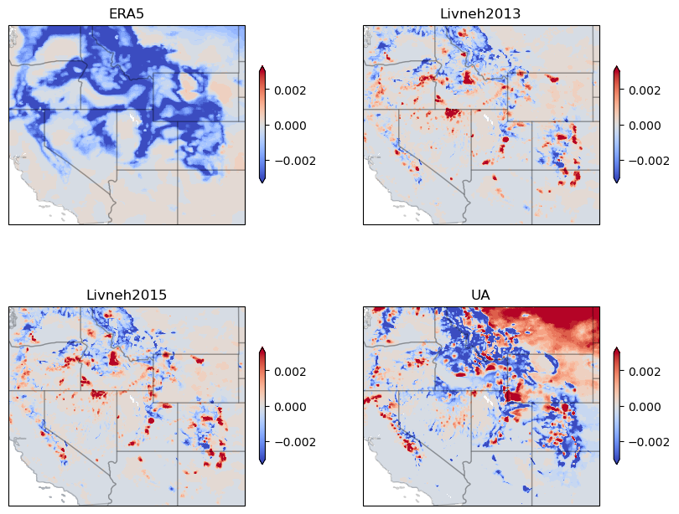
Uncertainty from “Observations”
A gridded high-res nSWE observation is not available. Need to use model simulations/data products instead
Model Simulations:
Livneh2013-VIC (6km)
Livneh2015-VIC (6km)
ERA5-Land (9km regridded to 6km)
CONUS404 (to be added, 4km)
Data product:
UA-PRISM (4km, regridded to 6km)
Figure. Climatology and trend maps of April 1st nSWE from selected “observations”. ERA5, Livneh2013 and Livneh2015 are selected from 1953-2009, UA from 1984-2020.

Slide 8
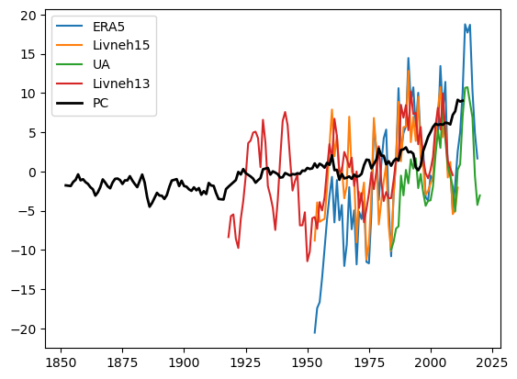
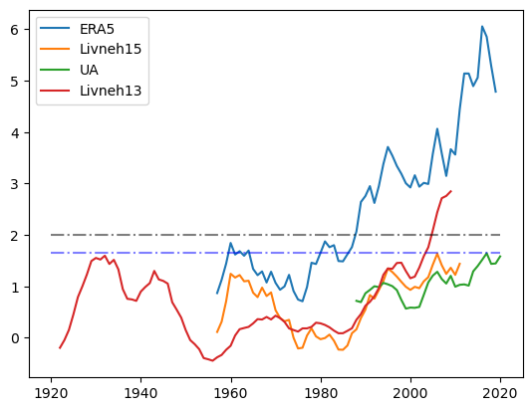
Projection and SNR
Figure. Projected pseudo-PC of “observation” datasets (left) and Signal-to-Noise ratio (right) with 3-yr rolling average. ERA5 and Livneh15 starts from 1953, Livneh13 from 1918 and 1984 for UA.

Slide 9

Conclusions and Future Work
Noise is persistent in the small local domain with high horizontal resolution.
The uncertainty in “observation” snowpack is still here even with nSWE.
The signal is detectable with long enough data records.
Use ML methods (ForceSMIP) to remove noise further and constrain projected PC/pseudo-PC.
duan5@llnl.gov

